Slide 1
Decision Support and Intelligent Systems

Slide 2
Decision Making
Information is used to make decisions. Decision making is not a single activity that takes place all at one.
The process consists of several different activities that take place at different times.
The decision maker has to identify and understand problems.
Once perceived, solutions must be designed; once solutions are designed, choices have to be made about a particular solution; finally, the solution has to be carried out and implemented.
Four different stages in decision making are
Intelligence
Design
Choice
Implement

Slide 3
Decision Support System
The design support system basically helps the information system in the intelligence phase to identify the problem and then go to the design phase for solution.
The choice of selection criteria varies from problem to problem.
It is required to go through these phase again and again till the satisfactory solution is found.

Slide 4
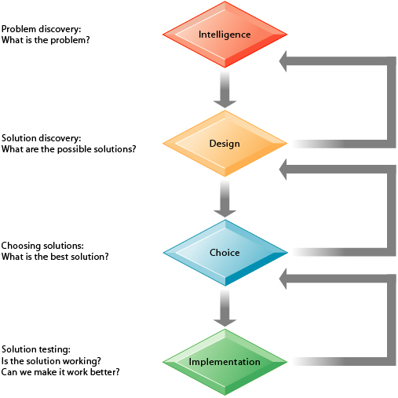
Decision Making Stages

Slide 5
Decision Support System
A decision support system is an integrated set of computer tool that allows a decision maker to interact directly with computers to create information and it useful in making semi-structured and unstructured decisions.
The software components for decision-support systems are a language system which enables the user to interact with the decision-support system, a problem-processing system.
A properly designed DSS is an interactive software-based system planned to help decision makers and to identify and solve problems and make decisions.
Notes:
Decision support system helps in making a decision.
Decision Support System (DSS) is a computer-based information system that supports business and organizational decision-making activities.

Slide 6
Continued
DSS serve the management, operations, and planning levels of an organization and help to make decisions, which may be rapidly changing and not easily specified in advance.
DSS are used to collect data, analyze and shape the data that is collected, and make sound decisions or construct strategies from analysis whether computers, databases, or people are involved generally it does not matter.
The nature of the decision is such that the decision makers need a variety of information. The reason for changing the demands is also because the methods of decision making a change from time to time.
Notes:
Decision Support System is a general term for any computer application that increases a person or group’s ability to make decisions.

Slide 7
DSS Types of Decisions
Structured / Programmed Decisions :
Schedule decisions
Organization develops specific process for handling
Rules of decision making system are predetermined

Slide 8
DSS Types of Decisions
Unstructured / Non-programmed Decisions :
Repetitive decisions
Handled by general problem solving process
Decision taken by Decision Support Systems
Rules of decision making system are not fixed or predetermined
It requires every time the user has to go through the decision-making cycle.
Decision support systems can be built in case of programmable decision situation.

Slide 9
DSS Types of Decisions
Semistructured Decisions:
Some decision procedures can be specified in advance, but not enough to lead to a definite recommended decision

Slide 10
Decision Support System Models
Types of Decision Support System Models :
Behavioural Models
Management Science Models
Operation Research Models
Types of Models
DSS
Behavioural Models
Management Science Models
Operation Research Models

Slide 11
Behavioural Models
Behavioural Models :
The decision maker can make the decisions for such behavioral relationships.
For eg: The trend (development) analysis, forecasting and statistical analysis models.
The trend analysis indicates how different variables behave in trend setting in the past and hence in future.
In Market Research method, they can forecast or judge the behavior of the customers buying decisions. (i.e. The questionnaire are designed and computerized to evaluate customer’s buying behavioral).

Slide 12
Management Science Models
Management Science Models :
These models are developed on the principles of the business management, accounting and economics.
For eg: the budgetary systems, cost accounting system, inventory management system.
In the budgetary system, budgets are used for planning and control.
In all the organization, budgets are prepared with the use of graphical representation in the form of line charts or bar charts.
For eg : Sales Budget, Production Budget

Slide 13
Operation Research Models
Operation Research Models :
The Operation Research models are the mathematical models in providing guidelines to managers for making effective decisions within the state of the current information, or in seeking further information if current knowledge is insufficient to reach a proper decision.
Some applications
• Telecommunications/Road/Rail Network Design
• Organization Supply Chain Strategy
• Just-in-Time Manufacturing Planning
• Retail Shop floor Layout
• Revenue, Pricing and Promotions
• Demand Forecasting
• Project Planning
For eg : Linear Programming is mathematical modeling technique useful for guiding quantitative decisions in business planning, industrial engineering, and—to a lesser extent in the social and physical sciences.

Slide 14
Benefits of Decision Support System
Benefits of Decision Support System :
Ability to view data and sensing the problem through the different view.
Ability to understand and evaluate the business performance.
Ability to understand the problem and its result, and ability to judge the impact on business.
Ability to evaluate the impact of any change in the business performance and enabling to focus on the areas where impact is negative.
Ability to view the complex scenario or problem and to analyze it and develop alternatives to solve the problem.
Ability to make a better decisions due to quick analysis.
Ability to control the risk exposure in decisions.
Notes:
All these abilities together make a decision maker, a capable person to handle any complex business scenario or problem. Manager through DSS, builds capability to execute the decision-making process ‘Intelligent – Design – Choice – Implement ’ built by Herbert Simon.

Slide 15
Group Decision Support System
Group Decision Support System
Information technology supports decision-making where there is a group participation. Such decision support system is called as Group Decision Support Systems (GDSS).
GDSS has come to mean computer software and hardware used to support group functions and processes.
GDSS supports Manager and Staff working in groups.
Notes:
In all four configurations, GDSS support software is available on server for members to use. In all the configuration models, the group members work together in a collaborative manner.

Slide 16
Group Decision Support System
There are four configurations of group members are possible.
Group members in one room operating on network with common display screen to share the display for all members.
Group members sit at their respective locations and use their desktop to interact with other members.
Group members are in different cities and they come together through teleconferencing or video conferencing with prior planning GDSS operations.
Group members are at remote locations may be in different countries and they come together through long distance telecommunication network.

Slide 17
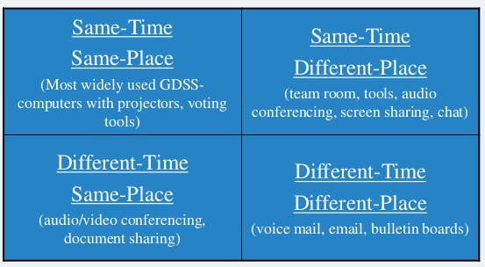
GDSS Time/Place Environment

Slide 18

WHY USE GDSS?
High level managers can spend 80% of their time making decisions in groups. Applied correctly, GDSS can reduce this time, arriving at a better decision faster.
GDSS provides the hardware, software, databases and procedures for effective decision making.

Slide 19
Advantages of GDSS
Parallel Communication – eliminate monopolizing, providing increased participation, better decisions
Automated record keeping – no need to take notes, they’re automatically recorded
Ability for virtual meetings – only need hardware, software and people connected
Portability - Can be set up to be portable…laptop
Global Potential - People can be connected across the world.

Slide 20
Disadvantages of GDSS
Cost – infrastructure costs to provide the hardware and software/room/network connectivity can be very expensive
Security – especially true when companies rent the facilities for GDSS; also, the facilitator may be a lower level employee who may leak information to peers
Technical Failure – power loss, loss of connectivity, relies heavily on bandwidth and LAN/WAN infrastructure properly setup system should minimize this risk

Slide 21
Enterprise Decision Support System
The Enterprise Decision Support System is a multi-disciplinary organization that provides technical and program/project leadership for Departmental Information Technology, applications and systems.
Enterprise use decision support systems to quickly perform complex analyses over large amounts of data whose results are used to inform critical business decisions.

Slide 22
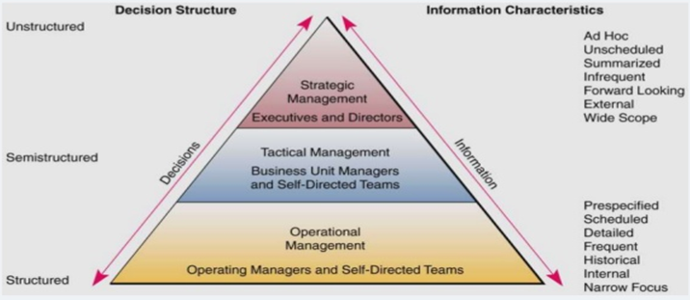
Enterprise and Decision Making
Notes:
Amount of structure is typically tied to management level
Operational – more structured
Tactical – more semistructured
Strategic – more unstructured

Slide 23
Executive Decision Support System
Executive Decision Support System is a computer-based technology designed specifically for the information needs of top executives level and provides for:
Rapid access to timely information;
Direct access to management reports;
Very user friendly and supported by graphics.
Executive Decision Support Systems support the informational roles of executives.
Notes:
An executive decision support system is a type of computerized information system designed to aid business executives in the decision-making process.
Such executives are often asked to process information coming from multiple sources before eventually taking all of the information and attempting to make sense of it. By using an support system, executives have all of the necessary information at their fingertips and can break that information down in a much more efficient manner. These systems are generally formatted as computer software which is easy to use, quickly responsive to new information, and available to other managers who are expected to provide input to top executives.

Slide 24
ESS(Continued)
Executive Support Systems – specialized decision support systems designed to meet the needs of senior management.
Exception reporting – reporting of only the results that deviate from a set of standards.
Drill down reporting – investigating information in increasing detail.
Include analysis support, communications, office automation and intelligence support.

Slide 25
Knowledge
Knowledge is something that comes from information processed by using data.
Knowledge is applied by knowledge workers who are involved in a particular job or task.
People use their knowledge in making decisions as well as many other actions
Knowledge is information that is contextual, relevant, and actionable.

Slide 26
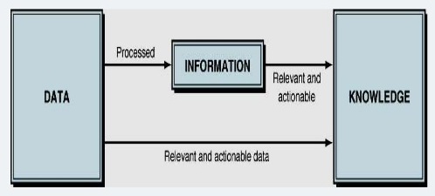
Data, Information and Knowledge

Slide 27
Data, Information and Knowledge
Data
refers to isolated facts such as individual measurement No meaning on their own
Information
fact about situation, person, events
Knowledge
experience

Slide 28
Knowledge Management
Knowledge Management (KM) comprises a range of strategies and practices used in an organization to identify, create, represent, distribute, and enable adoption of insights and experiences
KM is a process that helps organizations identify, select, organize, disseminate, and transfer important information and expertise that are part of the organization’s memory.
KM is the process of systematically and actively managing and leveraging stores of knowledge in an organization

Slide 29
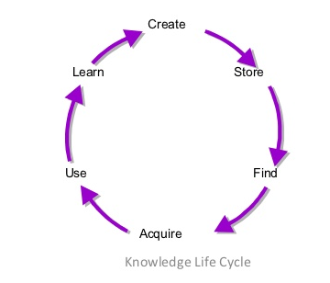
Knowledge Management System
Knowledge Management System refers to a (generally IT based) system for managing knowledge in organizations for supporting creation, capture, storage and distribution of information.

Slide 30
Knowledge Management System
Knowledge Management System
Create : Knowledge must be created either within or outside the organization. This is typically comprised of iterative tacit and explicit loops until the knowledge is ready for distribution for those outside the creating group.
Store : Knowledge can be stored somewhere, either tacitly or explicitly so that it is accessible for others to find and use.
Find : Those who need the specific knowledge must then find out where it is, when they need it, by searching in the right places and asking the right people.

Slide 31
Knowledge Management System
Acquire : Once the knowledge source is found, the user will then go through the act of actually acquiring it. This will involve gaining personal knowledge from other humans or documented sources.
Use : Once acquired, the knowledge can be put to use towards some productive purpose.
Learn : Having been used, perhaps repeatedly, the user will learn what worked well and not so well as a result of applying the knowledge gained. This can then be taken as significant input into further iterations of the knowledge creation and distribution process.

Slide 32
Knowledge Management System
IT that helps gather, organize, and share business knowledge within an organization
Hypermedia databases that store and disseminate business knowledge. It may also be called knowledge bases.
Best practices, policies, business solutions entered through the enterprise knowledge portal.

Slide 33
Knowledge Based Expert System
A Knowledge Based System is a computer program that uses artificial intelligence to solve problems within a specialized domain that ordinarily requires human expertise.
Typical tasks for expert systems involve classification, diagnosis, monitoring, design, scheduling, and planning for specialized tasks.
Knowledge-based system is a more general than the expert system.

Slide 34
KBS as Real world Problem Solvers
Problem-solving power does not lie with smart reasoning techniques nor clever search algorithms but domain dependent real-world knowledge.
Real-world problems do not have well-defined solutions
KBS allow this knowledge to be represented and creates an explained solution.
KBS draws upon the knowledge of human experts captured in a knowledge-base to solve problems that normally require human expertise.
Uses Heuristic (cause-and-effect) rather than algorithms KBS as real-world problem solvers

Slide 35
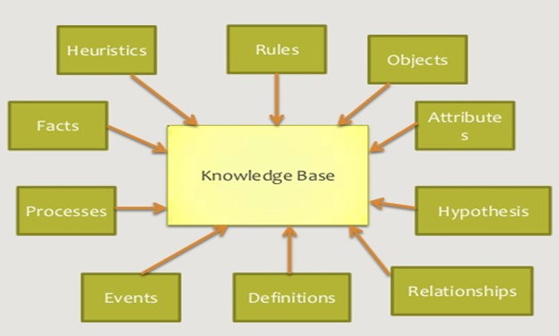
Knowledge Base
Notes:
A knowledge base is a technology used to store complex structured and unstructured information used by a computer system.

Slide 36
Expert System
Expert System is an extension of the decision support system.
Expert system is an information system application that captures the knowledge and expertise of a problem solver or decision maker, and then simulates the ‘thinking’ of that expert for those who have less expertise.
Expert systems are implemented with artificial intelligence technology, often called expert system shells.
Expert System application areas in action
1.Medical Diagnosis
2.Telephone Network Maintenance
3.Detection of Common Metals

Slide 37
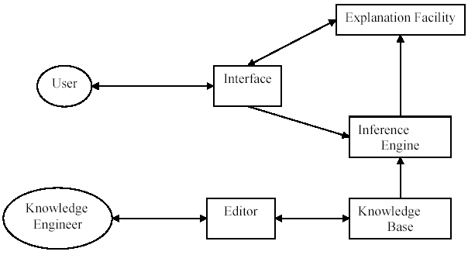
Expert System Architecture
Architecture of a Typical Expert System

Slide 38
Inference Engine
An inference engine tries to derive answers from a knowledge base.
It is the brain of the expert systems that provides a methodology for reasoning about the information in the knowledge base, and for formulating conclusions.
User Interface
It enables the user to communicate with an expert system.

Slide 39
Knowledge Engineer
Knowledge Engineer
A knowledge engineer is a computer scientist who knows how to design and implement programs that incorporate artificial intelligence techniques.
Knowledge Engineering
The art of designing and building the expert systems is known as Knowledge Engineering, knowledge engineers are its practitioners.
Knowledge engineering relies heavily on the study of human experts in order to develop intelligent & skilled programs.

Slide 40
Knowledge Engineer
The engineer then translates the knowledge into a computer- usable language, and designs an inference engine, a reasoning structure, that uses the knowledge appropriately.
He/she also determines how to integrate the use of uncertain knowledge in the reasoning process, and what kinds of explanation would be useful to the end user.
When the expert system is implemented, it may be:
The inference engine is not just right
Form of representation of knowledge is awkward
An expert system is judged to be entirely successful when it operates on the level of a human expert.

Slide 41
Expert Systems
Characteristics of Expert System
Like a human expert, an expert system is expected to
Be specialist : know facts and procedural rules
Use heuristics : interpolate from known facts
Justify its conclusions : to establish credibility and confidence.
The user can ask: be able to learn : be able to absorb new knowledge and apply it estimate the reliability of its answer.

Slide 42
Benefits of Expert System
Benefits of Expert System
Increased output and productivity
Decreased decision making time
Increased process and product quality
Reduced downtime (machine failure detect and repair time)
Capture of scarce expertise
Easier equipment operation
Elimination of the need for expensive equipment
Operations in hazardous environments (no human required.)
Ability to work with incomplete or uncertain information
Knowledge transfer to remote locations
Enhancement of other information systems

Slide 43
Intelligent System
Intelligent systems is a term that describes the various commercial applications of AI.
Artificial Intelligence (AI) is a subfield of computer science concerned with:
studying the thought processes of humans;
recreating those processes via machines, such as computers and robots.
Behavior by a machine that, if performed by a human being, would be considered intelligent.
Turing test is a test for artificial intelligence, in which a human interviewer, conversing with both an unseen human being and an unseen computer, cannot determine which is which: named for British Mathematician AI pioneer (Alan Turing).

Slide 44
Artificial Intelligence
A field of science and technology based on disciplines such as computer science, biology, psychology, linguistics, mathematics, & engineering
At the machine level, think like human and act like human means Artificial Intelligence.
Goal is to develop computers that can think, see, hear, walk, talk, and feel.
Major thrust to development of computer functions normally associated with human intelligence reasoning, learning, problem solving

Slide 45
Domains of Artificial Intelligence
Domains of AI
Three major areas
Cognitive science
Robotics
Natural interfaces
Cognitive science
Focuses on researching how the human brain works & how humans think and learn
Applications
Expert systems
Adaptive learning systems
Fuzzy logic systems
Neural networks
Intelligent agents

Slide 46
Domains of Artificial Intelligence
Robotics
Produces robot machines with computer intelligence and computer controlled, human like physical capabilities
Natural interfaces
Natural language and speech recognition
Talking to a computer and having it understand
Virtual reality

Slide 47
Neural Networks
Neural networks is a system of programs and data structures that approximates the operation of the human brain.
Neural networks are particularly good at recognizing subtle, hidden and newly emerging patterns within complex data as well as interpreting incomplete inputs.

Slide 48
Virtual Reality
Virtual reality is plainly speaking, seeing an imaginary world, rather than the real one. Seeing, hearing, smelling, testing, feeling. The imaginary world is a simulation running in a computer. The sense data is fed by some system to our brain.
A medium composed of interactive computer simulations giving users the feeling of being present in the simulations.

Slide 49
Why Virtual Reality is needed?
Operations in dangerous environments
There are still many examples of people working in dangerous or hardship environments that could benefit from the use of VR-mediated teleportation.
Workers in radioactive, space, or toxic environments could be relocated to the safety of a VR environment where they could handle any hazardous materials without any real danger using teleoperation or telepresence.

Slide 50
Why Virtual Reality is needed?
Why Virtual Reality is needed?
Scientific Visualization
Scientific Visualization provides the researcher with immediate graphical feedback during the course of the computations and gives him/her the ability to 'steer' the solution process.
Application at NASA Ames Research Center is the Virtual Planetary Exploration. It helps planetary geologists to remotely analyze the surface of a planet. They use VR techniques to roam planetary terrains.
NASA VR Mars navigation simulation Geologists remotely analyzing the surface of a planet at NASA

Slide 51
Why Virtual Reality is needed?
Why Virtual Reality is needed?
Medicine
Until now experimental research and education in medicine was mainly based on dissection and study of plastic models. Computerized 3D human models provide a new approach to research and education in medicine. Experimenting medical research with virtual patients will be a reality.
We will be able to create not only realistic looking virtual patients, but also histological and bone structures. With the simulation of the entire physiology of the human body.

Slide 52
Why Virtual Reality is needed?
Why Virtual Reality is needed?
Education and training
The most common example is the flight simulator. This type of simulator has shown the benefits of simulation environments for training. They have lower operating costs and are safer to use than real aircraft.
They also allow the simulation of dangerous scenarios not allowable with real aircraft.

Slide 53
Data Mining
Data mining is the search for relationships and global patterns that exist in large databases but are `hidden' among the vast amount of data, such as a relationship between patient data and their medical diagnosis.
Data Mining is also known as knowledge Discovery in Databases(KDD)
These relationships represent valuable knowledge about the database and the objects in the database and, if the database is a faithful mirror, of the real world registered by the database.

Slide 54
Data Mining
Data mining refers to using a variety of techniques to identify nuggets of information or decision-making knowledge in bodies of data, and extracting these in such a way that they can be put to use in the areas such as decision support, prediction, forecasting and estimation.
The data is often voluminous, but as it stands of low value as no direct use can be made of it; it is the hidden information in the data that is useful.

Slide 55
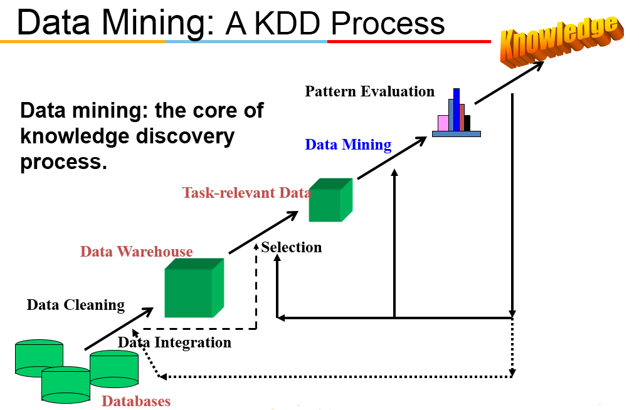

Slide 56
Steps of a KDD Process
Learning the application domain:
relevant prior knowledge and goals of application
Creating a target data set: data selection
Data cleaning and preprocessing: (may take 60% of effort!)
Data reduction and transformation:
Find useful features, dimensionality/variable reduction, invariant representation.
Choosing functions of data mining
summarization, classification, regression, association, clustering.
Choosing the mining algorithm(s)
Data mining : search for patterns of interest
Pattern evaluation and knowledge presentation
visualization, transformation, removing redundant patterns, etc.
Use of discovered knowledge

Slide 57
Why is Data Mining necessary?
Make use of your data assets
There is a big gap from stored data to knowledge; and the transition won’t occur automatically.
Many interesting things you want to find cannot be found using database queries
“find me people likely to buy my products”
“Who are likely to respond to my promotion”

Slide 58
Why Data Mining
Credit ratings/targeted marketing:
Given a database of 100,000 names, which persons are the least likely to default on their credit cards?
Identify likely responders to sales promotions
Fraud detection:
Which types of transactions are likely to be fraudulent, given the demographics and transactional history of a particular customer?
Customer relationship management:
Which of my customers are likely to be the most loyal, and which are most likely to leave for a competitor?
Notes:
Data Mining helps extract such information

Slide 59
Data Warehouse
Data Warehouse is a physical repository where relational data are specially organized to provide enterprise-wide, cleansed data in a standardized format.
Characteristics
Subject oriented, Integrated, Time Variant, Non-volatile
Web-based, Relational/multidimensional, Client/server, Real-time
Include metadata
Data Warehousing is process of constructing and using data warehouses which requires data integration, data cleaning, and data consolidation.
Notes:
A data warehouse is a read-only, informational database that is populated with detailed, summary, and exception information that can be accessed by end users and managers with DSS tools that generate a virtually limitless variety of information in support of unstructured decisions.

Slide 60
Data Warehouse—Subject-Oriented
Organized around major subjects, such as customer, product, sales
Focusing on the modeling and analysis of data for decision makers, not on daily operations or transaction processing
Provide a simple and concise view around particular subject issues by excluding data that are not useful in the decision support process

Slide 61
Data Warehouse—Integrated
Constructed by integrating multiple, heterogeneous data sources
relational databases, flat files, on-line transaction records
Data cleaning and data integration techniques are applied.
Ensure consistency in naming conventions, encoding structures, attribute measures, etc. among different data sources
E.g., Hotel price: currency, tax, breakfast covered, etc.
When data is moved to the warehouse, it is converted.

Slide 62
Data Warehouse—Time Variant
The time horizon for the data warehouse is significantly longer than that of operational systems
Operational database: current value data
Data warehouse data: provide information from a historical perspective (e.g., past 5-10 years)
Every key structure in the data warehouse
Contains an element of time, explicitly or implicitly
But the key of operational data may or may not contain “time element”

Slide 63
Data Warehouse—Nonvolatile
A physically separate store of data transformed from the operational environment
Operational update of data does not occur in the data warehouse environment
Does not require transaction processing, recovery, and concurrency control mechanisms
Requires only two operations in data accessing:
initial loading of data and access of data

Slide 64
OLTP vs. OLAP
Divide IT systems into transactional (OLTP) and analytical (OLAP).
In general, assume that OLTP systems provide source data to data warehouses, whereas OLAP systems help to analyze it.
OLTP (on-line transaction processing)
Major task of traditional relational DBMS
Day-to-day operations: purchasing, inventory, banking, manufacturing, payroll, registration, accounting, etc.
OLAP (on-line analytical processing)
Major task of data warehouse system
Data analysis and decision making

Slide 65
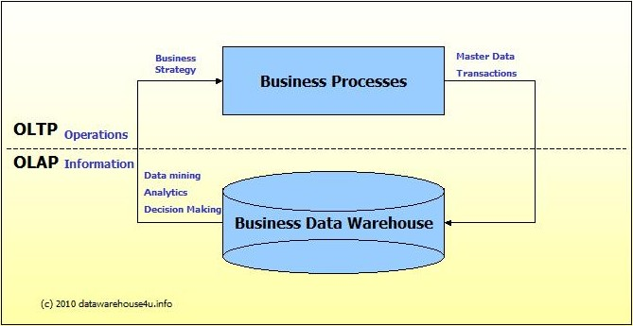
OLTP Vs OLAP
Notes:
Divide IT systems into transactional (OLTP) and analytical (OLAP). In general, assume that OLTP systems provide source data to data warehouses, whereas OLAP systems help to analyze it.

Slide 66
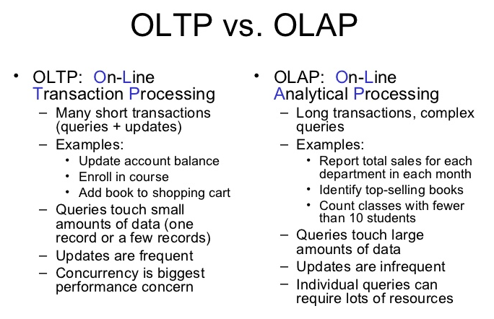
Notes:
Distinct features (OLTP vs. OLAP):
User and system orientation: customer vs. market
Data contents: current, detailed vs. historical, consolidated
Database design: ER + application vs. star + subject
View: current, local vs. evolutionary, integrated
Access patterns: update vs. read-only but complex queries

Slide 67
Thank you

